Slide 1


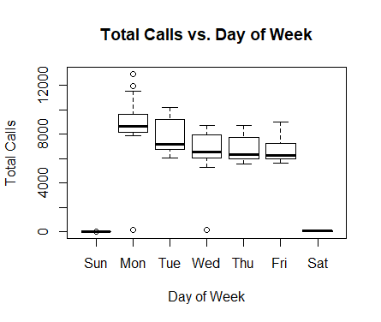
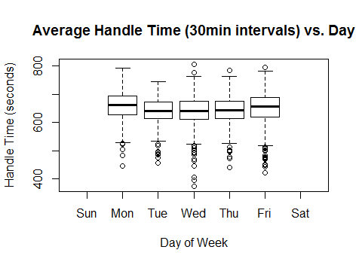
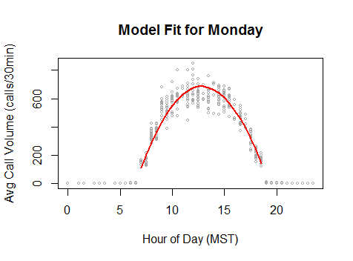
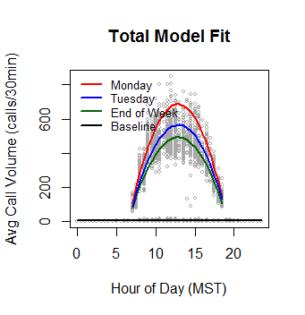
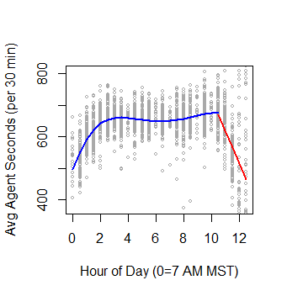
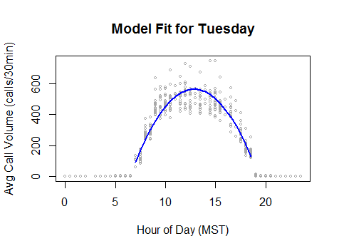
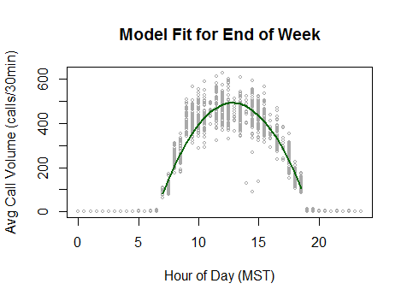
Models for Call Volume and Agent Handling Time in a Call Center to Predict Required Staffing Levels
Nicholas Smith, Jaden Jackson, Weilun Mai
Weber State University, Ogden
Introduction
Results
Discussion
Clearview Live is a company based in Roy Utah, that creates analytics and dashboard software. The software collects and analyzes data from existing company enterprise wide software such as
Enterprise Resource Planning
Customer relationship management
Call center phone data etc.
Their goal is to provide data in a digested form to allow businesses to improve their efficiency and customer satisfaction
The company provided WSU with 4 months of raw data from 2018 for a call center with the request that models be developed for call volume and agent handling time. These models would be used to assist in determining required staffing levels for the call center.
Fig 1 Call Volume vs Day of the Week
Fig 3 Agent Handle Time vs Day of the Week
Fig 5 Call Volume vs Time of Day on Monday
Methodology
As with any large data set, the raw data provided were “messy” and needed to be “scrubbed” before analysis.
Using the scrubbed data set the following approach was taken
The number of calls per 30 minute periods throughout the work day were calculated for Monday through Friday
The length of the calls (agent handling time – AHT) in these same time periods was calculated in seconds.
Calls not connected to the agent i.e. of zero seconds length were included in the model for call volume but not in the model for AHT.
All work was carried out using the open source software ‘R’ and associated libraries.
The scrubbed data were split into a training 70% of the data and a testing data set.
Using the training data set common modeling techniques such as general linear modeling (regsubsets from the leaps library was used) were applied to the data and various models created.
These models were then applied to the testing data set and the adjusted R squared values (the amount of variance explained by the models) calculated.
A trade off of the model complexity vs the adjusted R squared was made to select the preferred model
Reducing the model complexity improves the interpretability of the model and should lead to a better trade off between the bias and variance and yield a more useful model
.
Fig 2 Call Volume vs Time of Day Military Time (MST)
Fig 4 Agent Handle Time vs Hours from Start of Shift
Fig 6 Call Volume vs Time of Day on Tuesday
As can be seen from figure 1 the call center operates five days a week and there are no calls taken at the weekend or on US holidays. Monday appears to have a slightly higher call volume but all other days of the week are essentially equivalent.
Figure 2 shows that there is a ramp up in the call volume at the start of the day between 7:00am and 9:00am and a decrease at the end of the day between 6:00pm and 7:00pm. CHECK However, the call volume is essentially constant through the main part of the day. CHECK
Figure 3 shows that the agent handling time does not appear to significantly vary throughout the week
Figure 4 shows that the agent handling time may be slightly faster at the beginning of the day but is essentially constant throughout the day until near the close of business when it does become quicker as agents prepare to go off shift.
The selected call volume model is:
Call Volume (if Monday) = 8.2635 + 213.996*(workHour-6.5) - 16.8979*((workHour-6.5)^2)
Call Volume (if Tuesday) = 8.2635 + 174.5085*(workHour-6.5) - 13.6978*((workHour-6.5)^2)
Call Volume (if end of week) = 8.2635 + 152.7183*(workHour-6.5) - 12.0564*((workHour-6.5)^2)
It can be seen that 95%% of the call volume can be explained by explained by time of day (in 30min intervals).
The preferred agent handling time model is:
AHT = 495.92 + 129.99*workHour - 35.29*(workHour^2) + 3.84995*(workHour^3) - 0.14404*(Hour^4)
AHT(if end of day) = 619.29-102.82*(workHour-11)
It can be seen that 36% of the agent handling time can be explained by time of day (in 30min intervals).
Fig 8 Call Volume vs Time of Day for End of Week
Conclusions and Future Work
Models have been created for both Call Volume and Agent Handling Time. Using these models a lower limit of the number of agents needed throughout the day can be calculated.
In practice, to calculate a needed staffing level other factors such as queue time, service level (i.e. what % of calls should be answered within a certain amount of time, historical levels of sickness/absenteeism etc) are needed.
All the above factors could be built into a model
In addition, data on the end customer satisfaction could be obtained and that used as a response variable to assist in determining the number of agents needed.
If HR practices allow, agent identifiers could be collected and best practices from the most effective agents identified and leveraged to others.
GUYS FYI ONLY = JUST AS A SANITY CHECK OF OUR NUMBERS – DOES THIS SEEM RIGHT TO YOU NICK?
TAKE OUT BEFORE PRINTING
The theoretical number of agents needed in any one 30 min time period on average is
(Avg AHT*Avg no.of calls)/ 30*60 secs
For a mid week day in the middle of the day this is very approximately 650*500/1800 =180
Notes:
Add parameters for high and low ferritin in the table.
Number of participants in for high and low ferritin groups
Units for figures and results

